Slide 1
Overview of Available Institutional Data
Ben Simpkins- Director of Data Management and Institutional Research
Chairs’ Council Retreat, 8/13/2015

Slide 2
Items to Cover
Data available from IEPR
Institutional data available on the web
How to access web reports
How to request additional data

Slide 3
Institutional Data Available from IEPR
Student Characteristics
College, Major, Concentration
Academic Preparation
Demographics
Grades
Status (Academic or Financial Standing, Candidacy)
Admission Status
Student Outcomes & Behaviors
Retention, Progression, Graduation (Cohort-based)
Transfer Out (National Student Clearinghouse)
Academic Performance
College or Major Switching
Test Scores
Advising
Tutoring
Course, Section Characteristics
Offerings
Section type (e.g., delivery method, honors, prescribed, block)
Grade Distribution/DFW Rate
Low/High Capacity, Cancellations
Faculty Characteristics
Department
Rank
Tenure
Workload
Course Section Evaluations
Financial Aid
Amount Awarded by Type
Eligibility (Currently Pell and TELS)
Federal, State, and Institutional Aid

Slide 4
Institutional Data Available on the Web
Degree and Enrollment Dashboard Reports
By College, Department, Major, Concentration
By Student Level & Type, FT/PT Status
By Demographic Variables (Age, Gender, Ethnicity)
By Academic Status
Trend Reports
Course Enrollment
Degree- Market Penetration

Slide 5
Institutional Data Available on the Web
Retention Dashboard Reports
1-year, Fall-to-Fall
University, College, and Major-level
By Demographic Variables and Academic Preparation
Multi-year Cohort Reports (outcomes- graduation, dropout, transfer)
Graduation Rate, Graduate Time-to-Completion
Persistence Tracking (i.e., Student Success Dashboard)
Special Populations
Pell Recipients
Vets
Students in Prescribed Course
Students with Associates’ Degree

Slide 6
Institutional Data Available on the Web
Academic Success Reports
Grade distribution by Course or College/Dept (includes DFWN %)
Enrollment by Academic Standing
Non-Returner Statistics
Academic Map – Course Offerings
“Unlisted” DFWN Reports (require URL to Access)
DFWN Statistics (by Instructor and Section)
DFWN General Education Courses
Program Review Reports

Slide 7
Institutional Data Available on the Web
Testing Reports
PRAXIS Summary/Detail Report
General Education Test Report
Census Reports (each term)- http://www.mtsu.edu/iepr/profiles.php
Factbook (each Fall)- http://www.mtsu.edu/iepr/factbooks.php

Slide 8
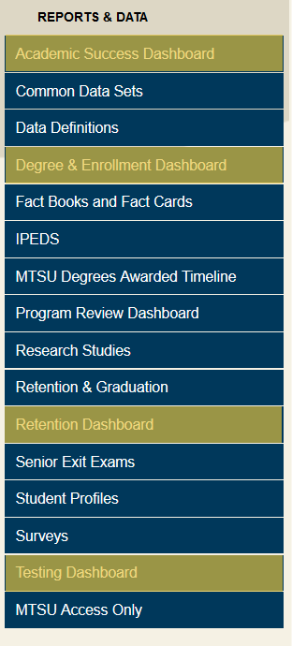
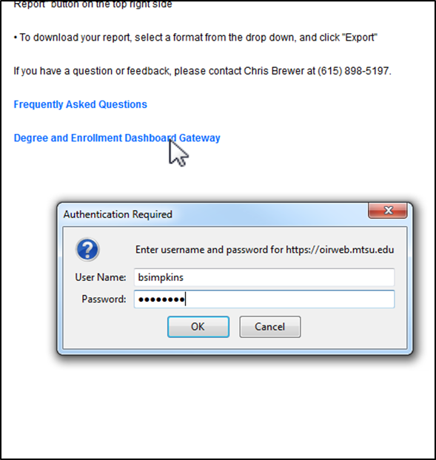
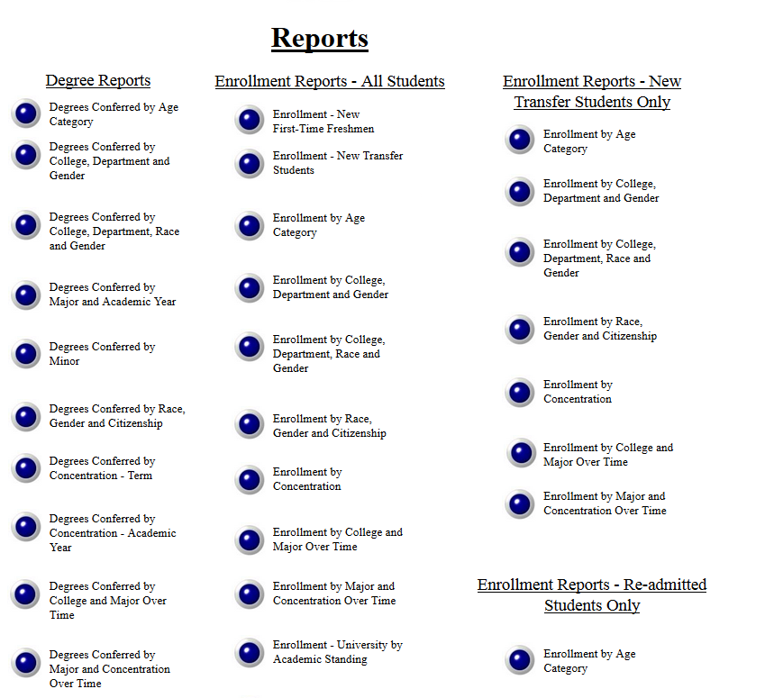
How to Access Web Reports
http://www.mtsu.edu/iepr
Authentication (Computer Login)
Report Gateway

Slide 9
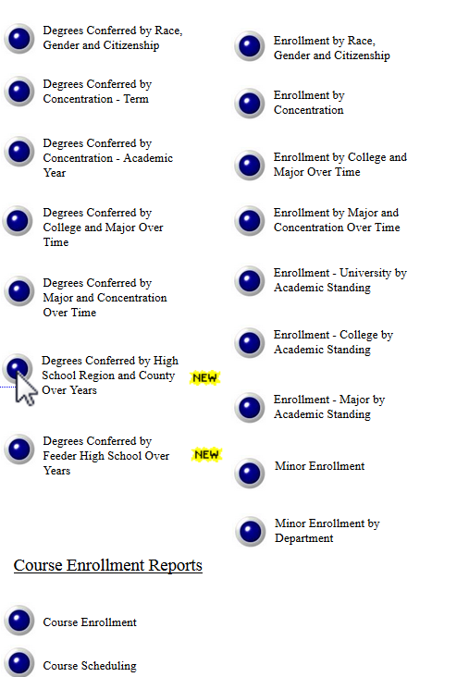
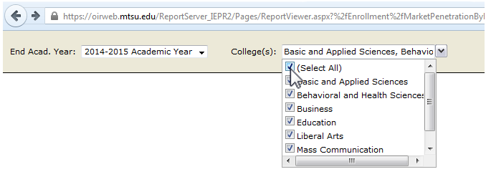
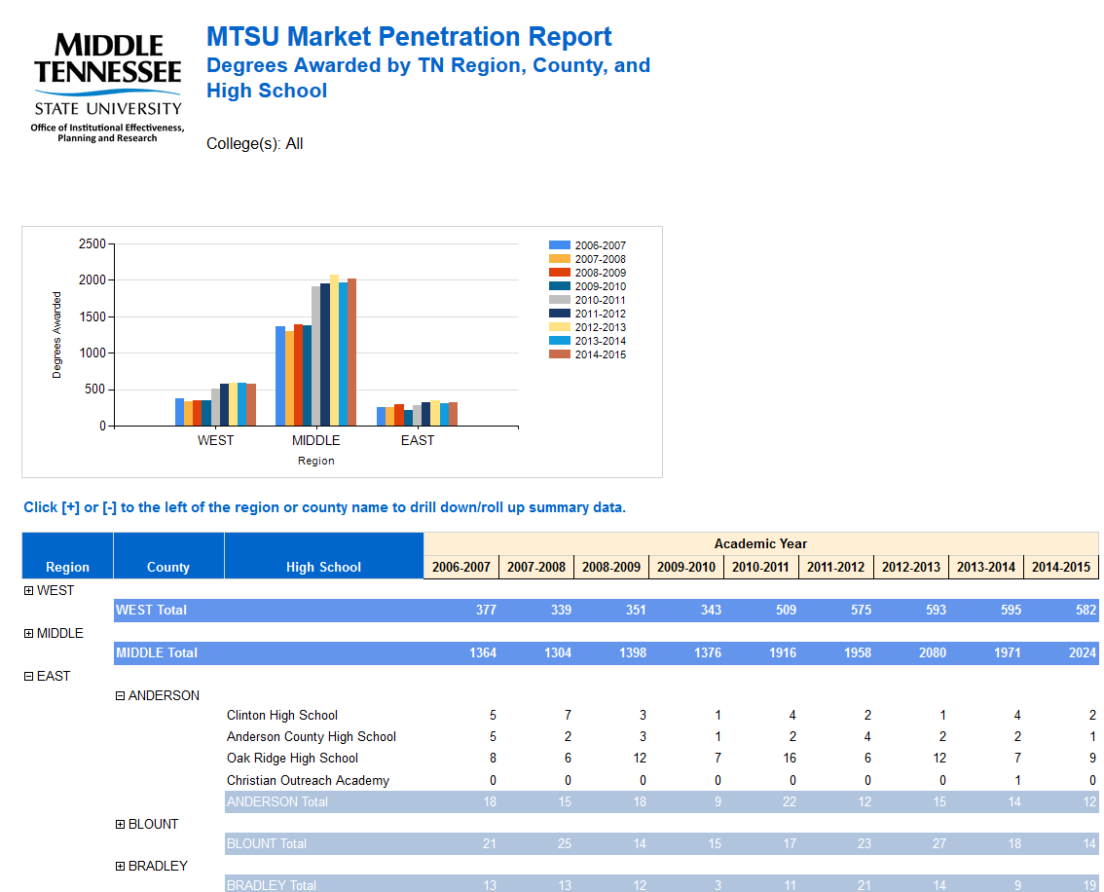
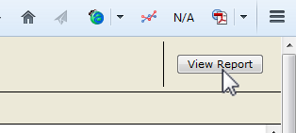
How to Access Web Reports
Select Parameters (Dropdowns)
View Report

Slide 10
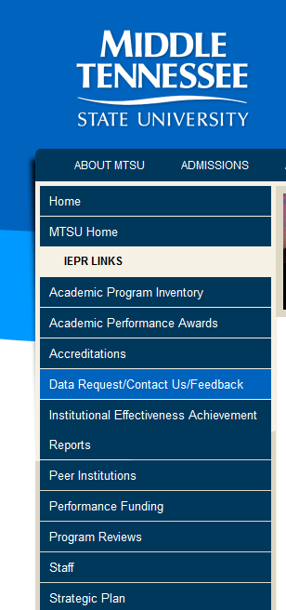
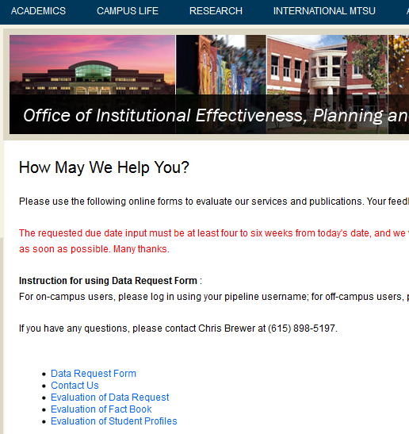
How to Submit a Data Request to IEPR
http://www.mtsu.edu/iepr

Slide 11
Dashboard Report Requests
More time-consuming to develop, but if enough need, IEPR will undertake
Need based on # of likely users, frequency of use
IEPR availability can fluctuate (e.g., SACS accreditation)
Over last 2 years- IEPR been able to accommodate all requests
Dashboards currently on task list:
High Capacity Course Section Report
Double Major Enrollment
Enrollment Planning
Transfer Out Characteristics

Slide 12
Questions, Comments…..

